Slide 1

Ukelele Colour, and Chromesthesia

Slide 2
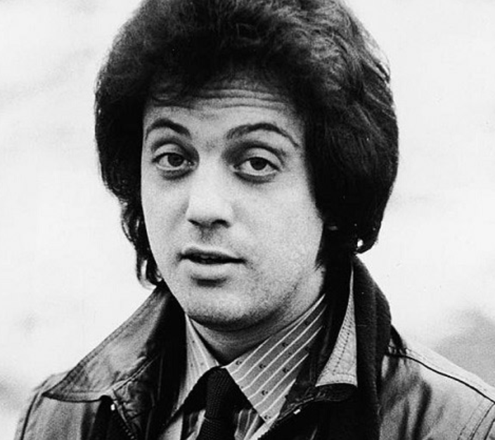
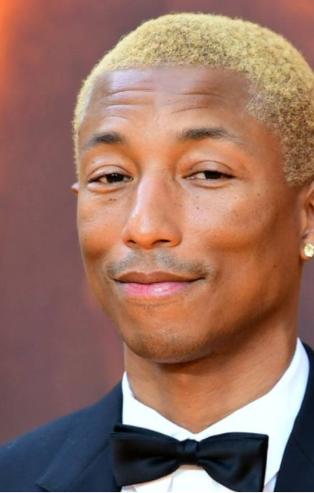
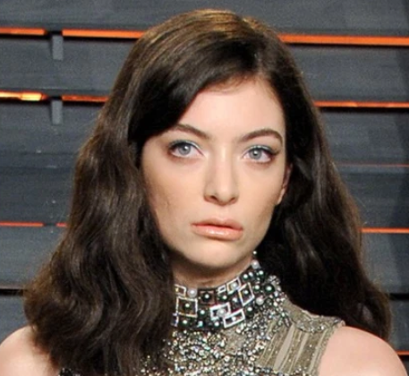
Chromesthesia
sound-to-color synesthesia
The idea that every colour maps to a note
These artists say they feel the colour when they hear the note

Slide 3

Method

Slide 4
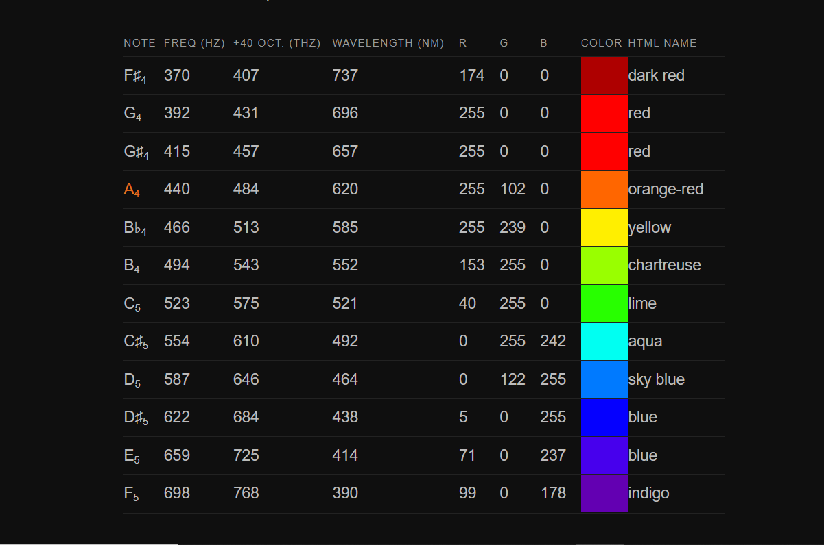

Slide 5
Approach
Each output in wekinator is programmed to map to a colour
Output 1 = R
Output 2 = G
Output 3 = B
Simply divide each value from the table by 255, program the three outputs into Wekinator, and train the model

Slide 6
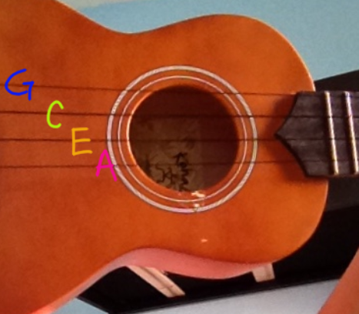
The four strings of the Ukelele
Notes:
This image is flipped, if you’re right handed, the A is on top

Slide 7
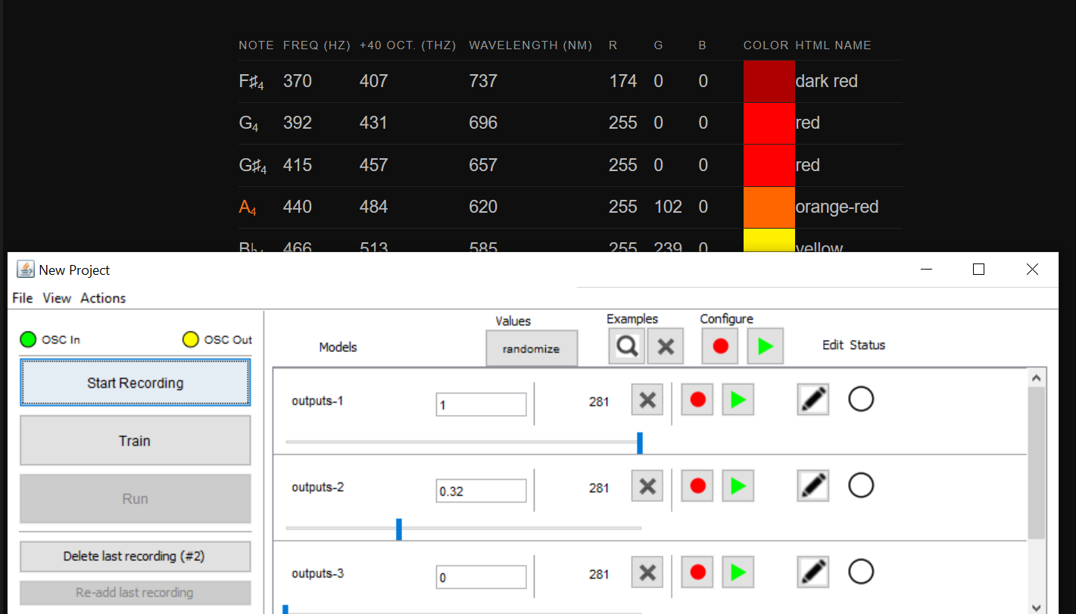
For Instance
This is what the A chord looks like in wekinator according to this chromosthesia model
Remember I’ve decided that 1 represents red 2 represents green 3 represents blue
And the values remain proportional
Notes:
For instance the A chord looks something like this

Slide 8
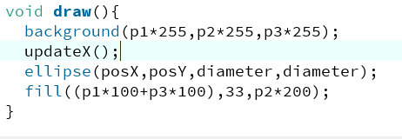
Processing
Wekinator does all the interpretation, allowing processing to be sent a very simple 3 outputs
This means the output is very simple to use on the Processing end
The three RGB values can be used to colour absolutely anything
I kept it very simple:

Slide 9
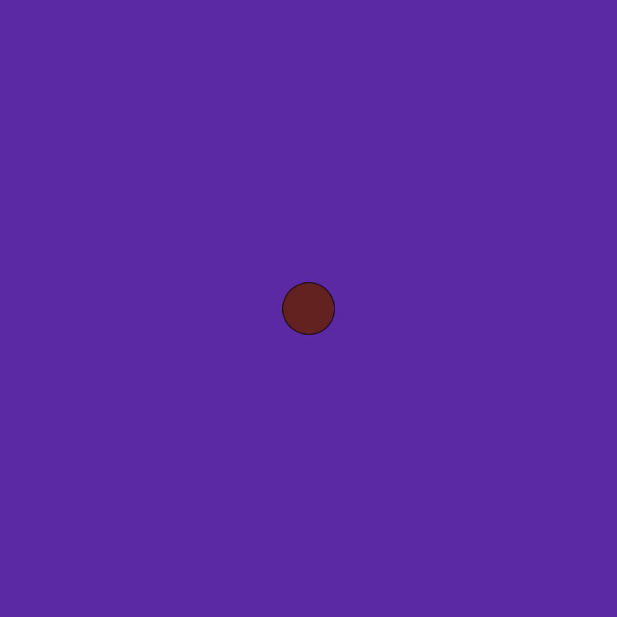
Result!

